Slide 1
Echocardiogram Prediction

Slide 2
Data Visualization and Data Preprocessing
PART ONE
PART TWO
Data analysis
CONTENTS
PART THREE
Other models
PART FOUR
Survival analysis
PART FIVE
Conclusion

Slide 3
Part1
PART One
Data Visualization
Data Preprocessing

Slide 4
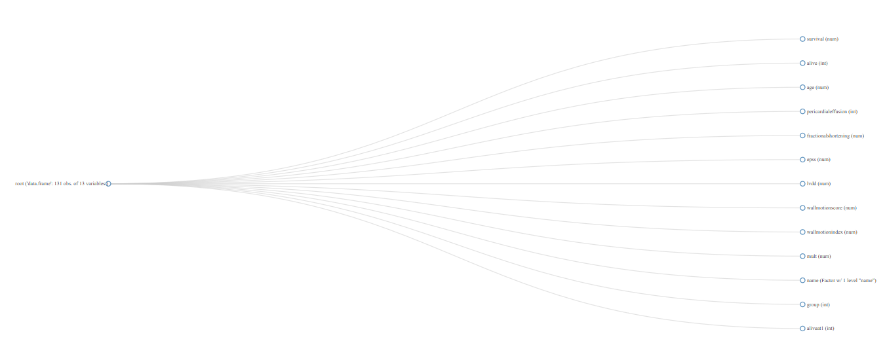
Data Visualization
Step One : Visualizing the data structure of the original data.
点此编辑内容
点此编辑内容
点此编辑内容
点此编辑内容

Slide 5
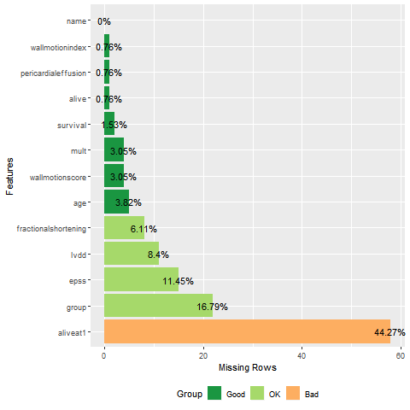
Data Visualization
Step Two:
Visualizing the missing
data value.

Slide 6
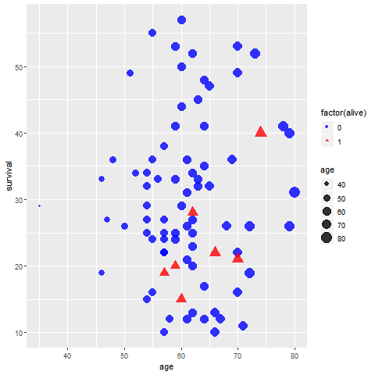
Data Visualization
Step Three:
Visually analyzing the original data.
Visually analyzing the data whose insignificantly predictive variables, missing values, and erroneous data are eliminated.

Slide 7
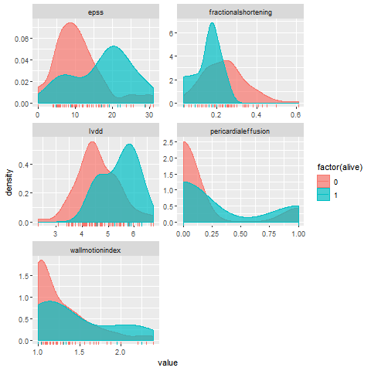
Data Visualization

Slide 8
Data Preprocessing：
Multiple Imputation
We remove the insignificant predictive variables from the original data, and use functions in the mice package to do multiple imputation and then artificially fill in missing values.

Slide 9
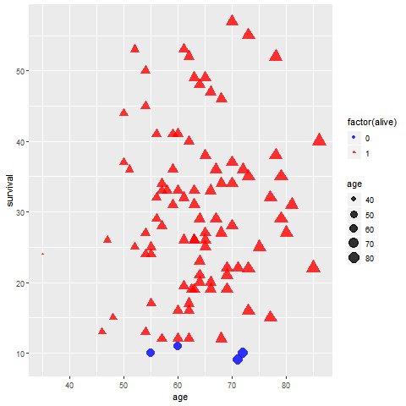
Data Visualization
Step Four:
Visually analyzing the interpolation data.
After the data of surviving individuals with a survival
period of less than 12 months were excluded, the interpolation data was read.

Slide 10
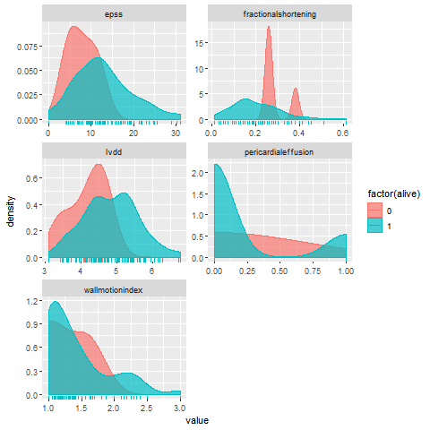
Data Visualization

Slide 11
Part2
Part Two
Data analysis
LOGISTIC Regression
Decision Tree model

Slide 12
LOGISTIC Regression
The initial model is model 1, The model obtained by stepwise regression of the selected variable is model2, and the AIC value of Model 2 is reduced by about 1.7 relative to Model 1. and there is no difference in the degree of fitting of the two models from the variance analysis of the two models, so that the model 2 is considered to be better than the model 1.

Slide 13
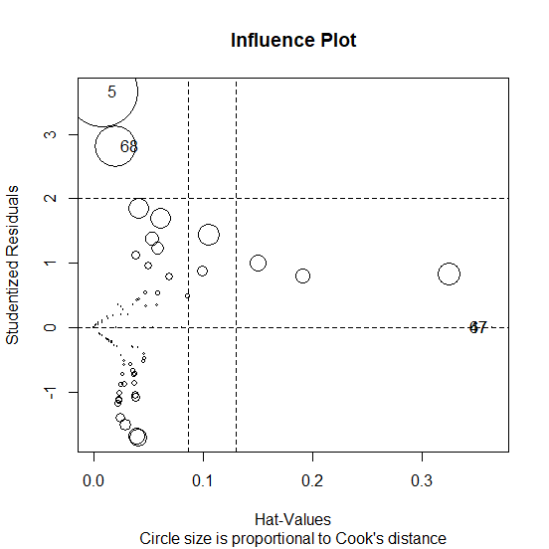
LOGISTIC Regression
The regression diagnosis of the model 2 is as follows: the variable pe in the model 2 is not significant ,and the influence diagram of the left graph shows that the model 2 has high influence points and high leverage points.

Slide 14
LOGISTIC Regression
Since model 2 has high influence points ,We perform robust logistic regression on the data to get model 3. all variables test is significant. From the ROC curve, the prediction accuracy of Model 3 is 0.899.

Slide 15
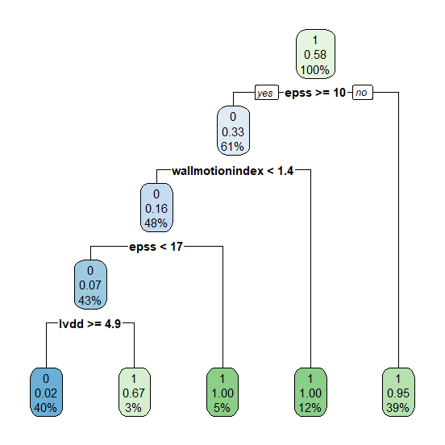
Decision Tree model
model 4
confusion matrix
Referencece /Prediction | 0 | 1
0 | 20 | 0
1 | 1 | 14

Slide 16
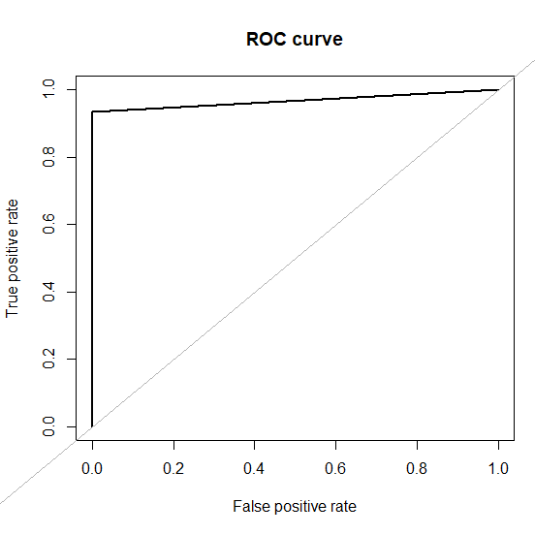
Decision Tree model
The data is divided into a training set and a test set, and the ratio of the division is close to 3:1.
The model 4 is obtained by fitting the decision tree to the training set. From the tree structure of Model 4: its variables are epss, lvdd, wall motion index. Then, from the confusion matrix of model 4 : For the data with a response variable equal to 0, all fit correctly.
Finally, the AUC = 0.967 is obtained from the ROC curve on the left. Therefore, the prediction accuracy of Model 4 is not bad.

Slide 17
Part3
Part Three
Other models
Random Forest
Neural Network
Thought

Slide 18








Random Forest
Sample
$$n_{1}$$
$$n_{2}$$
$$n_{3}$$
$$n_{n}$$
tree1
tree2
tree4
treeN
$${variable}_{11}$$
$${variable}_{12}$$
$${variable}_{1k}$$
… …
$${variable}_{21}$$
$${variable}_{22}$$
$${variable}_{2k}$$
$${variable}_{31}$$
$${variable}_{32}$$
$${variable}_{3k}$$
$${variable}_{n1}$$
$${variable}_{n2}$$
$${variable}_{nk}$$
}
Selected by gini-coefficient
}
New Sample
Vote

Slide 19
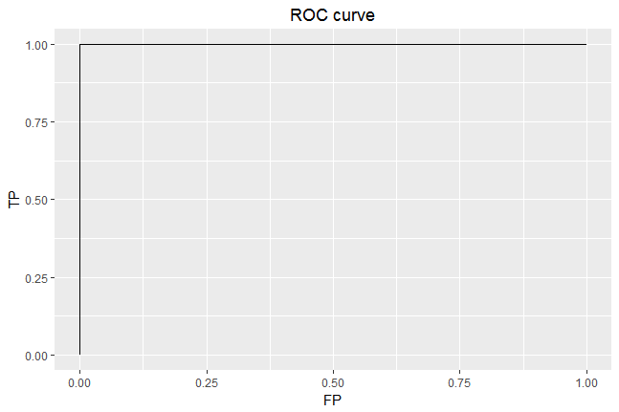
Random Forest
AUC:1
Almost no mistake
The cost of FN
The cost of FP
Are not equal

Slide 20
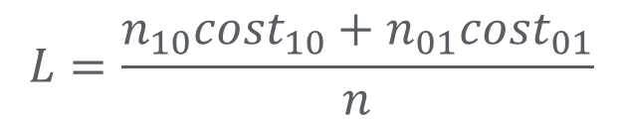
Random Forest
prediction
truth
> 1 year
< 1 year
Acceptable
Cost = 0
Cost = 1
$$L=\frac{n_{10}{cost}_{10}+n_{01}{cost}_{01}}{n}$$
> 1 year
Calculate cost-sensitive
Cost = 10
Cost = 0
< 1 year
LOSS:0.166
Very serious

Slide 21
Random Forest
The importance of variables
Variable | Gini-coefficient
pericardial-effusion | 2.02
wall-motion-index | 4.58
age | 5.53
fractional-shortening | 10.05
epss | 16.96
lvdd | 17.42
}
priority

Slide 22
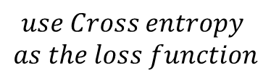






Neural Network
Forward propagation
Calculate
$${var}_{1}$$
$$h_{1}$$
$${var}_{1}$$
$$use Cross entropy$$
$$as the loss function$$
$$output$$
… …
output layer
$$h_{2}$$
$${var}_{k}$$
hidden layer
Estimate
Backward propagation
input layer

Slide 23

Neural Network
AUC:0.93
Only makes a few mistakes
Cost-sensitive loss:0.73

Slide 24
Thought
Neural network and Random Forest both perfom very perfect
71 | 0 | 0.26 | 9 | 4.6 | 1
Only 4 positive samples
Generate
SMOTE
73 | 0 | 0.25 | 10.3 | 4.7 | 1
4 samples
60 samples
70 | 0 | 0.26 | 9.6 | 4.7 | 1
}
Solving unbalance
similar
70 | 0 | 0.26 | 9.9 | 4.8 | 1
70 | 0 | 0.26 | 9.4 | 4.7 | 1
The model just remember the positive samples

Slide 25
Part4
Part Four
Survival analysis
Applicability
Simple KM survival analysis
Classified KM survival analysis
Cox survival analysis

Slide 26
Applicability
The survival time of the patients we observed can be divided into these cases, because the time we observe is limited, so only part of the patient's survival trajectory can be completely covered, and for other samples that are not fully observed, it is called censored data.
observstions
t1
t2
t3
t4
t5
t6
a
b
time

Slide 27
Applicability
In the data processing, patients are divided into two groups according to whether they could live for a year or not, referring to the patients' current survival status and the survival time. But those could lose a lot of original data information
regression equations
The direct use of models such as regression equations can cause large errors in the prediction.
censored
data
classification
models
survival
analysis
We also used survival analysis to make full use of the original data.

Slide 28
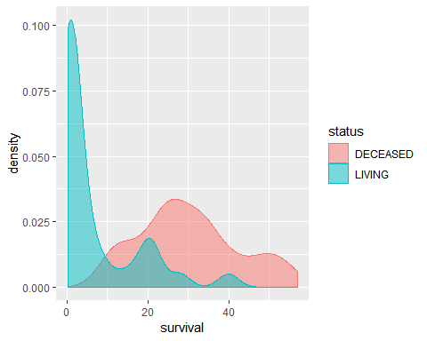
Applicability
the survival time of the deceased
patients is symmetrical
the survival time of the living patients
is right-biased
It means that the patients who have
been treated can be guaranteed a
longer survival time before they die.

Slide 29
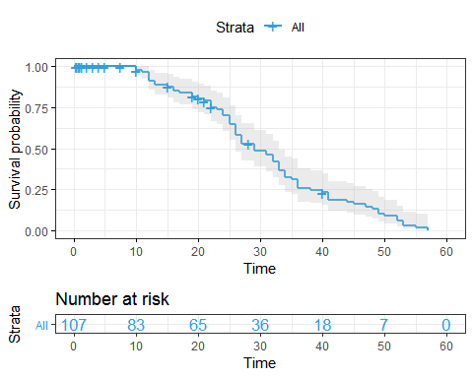
Simple KM survival analysis
This chart shows the estimated
value and confidence interval of the
survival curve of the deceased
patient.
The Kaplan-Meier survival curve
shows a blue solid line, and the
95% confidence limit shows a grey
background.
It is easy to see that the survival
rate of the deceased patient tends
to zero over time.

Slide 30
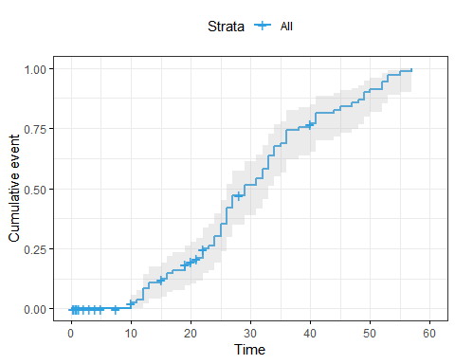
Simple KM survival analysis
Some researchers tend to generate cumulative mortality curves rather than survival curves, which show cumulative probability of experiencing events of interest.
From this chart, we can estimate the possibility of death at a certain point in time.

Slide 31
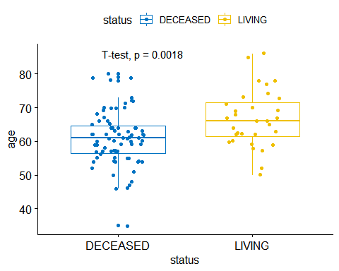
Classified KM survival analysis
According to the boxplot, we can see that the mean values of the deceased and the living are quite different.
Because the p value is less than 0.05, it indicates that the age of patients in different survival status has different expression.

Slide 32
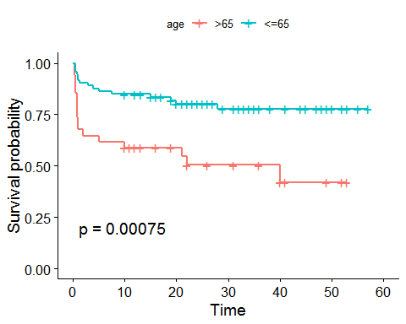
Classified KM survival analysis
It can be determined by the function that the best segmentation point of age is 65 years old, and the survival curve of different categories is drawn by dividing 65 years old.
With the extension of time, the difference in the rate of decline in the survival rate of patients in different age groups is still relatively large.
When using the logrank test method to test, the p value is close to 0, indicating that the grouping effect is great, that is, different ages have a great impact on the survival time.

Slide 33
Cox survival analysis
do not know the type of distribution of survival time
want to analyze the impact of multiple risk factors on survival time
study the relationship between predictors (covariates) and "time-events" through risk functions
overcome the current different living conditions of the patients and combine them with survival time for analysis

Slide 34
Cox survival analysis
 | coef | exp(coef) | se(coef) | z | Pr(>|z|)
age | 0.08139 | 1.08479 | 0.02154 | 3.778 | 0.000158
epss | 0.04566 | 1.04672 | 0.02165 | 2.109 | 0.034907
wmi | 1.18291 | 3.26384 | 0.39005 | 3.033 | 0.002424
For each additional unit of age, the patients' mortality rate will increase by 0.085.
For each additional unit of epss, the patients' mortality rate will increase by 0.047.
For each additional unit of wmi, the patients' mortality rate will increase by 2.263.

Slide 35
Part5
Part Five
Conclusion
Four models
Impact of factors

Slide 36
Four models
model | LOGISTIC Regression | Neural Network | Decision Tree model | Random Forest
auc | 0.899 | 0.930 | 0.967 | 1.000

Slide 37
Impact of factors
variances | age-at-heart-attack | 0.085
 | E-point septal separation | 0.047
 | wall-motion-index | 2.263

Slide 38
Thanks for listening

